Slide 1
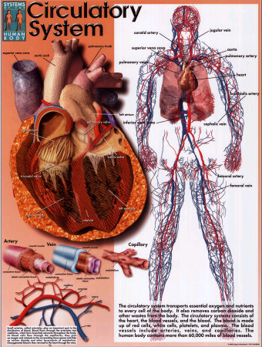
The
Circulatory
System

Slide 2
.
.

Slide 3
Objective:
Understand structure and function of blood vessels and blood cells of the circulatory system.

Slide 4
CFU

Slide 5
Main Vessels in the Circulatory System
Vessel | Structure of vessel wall | Function
Artery | Thick-walled and muscular | Carry blood to organs
Capillary | Very thin walls, only 1 cell thick | Allows materials to pass from blood to cells and cells to blood.
Vein | Thin-walled with valves | Carry blood back to the heart.

Slide 6
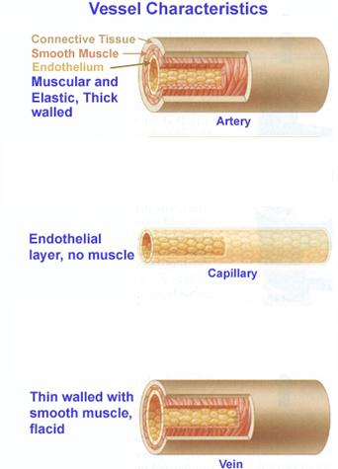
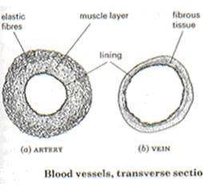
Cross Sections

Slide 7
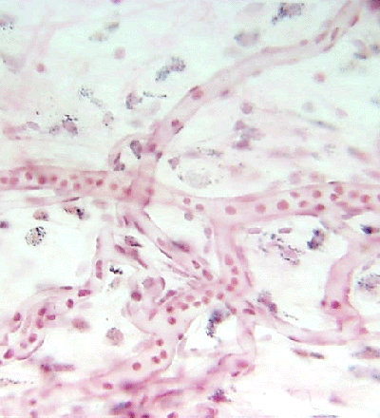
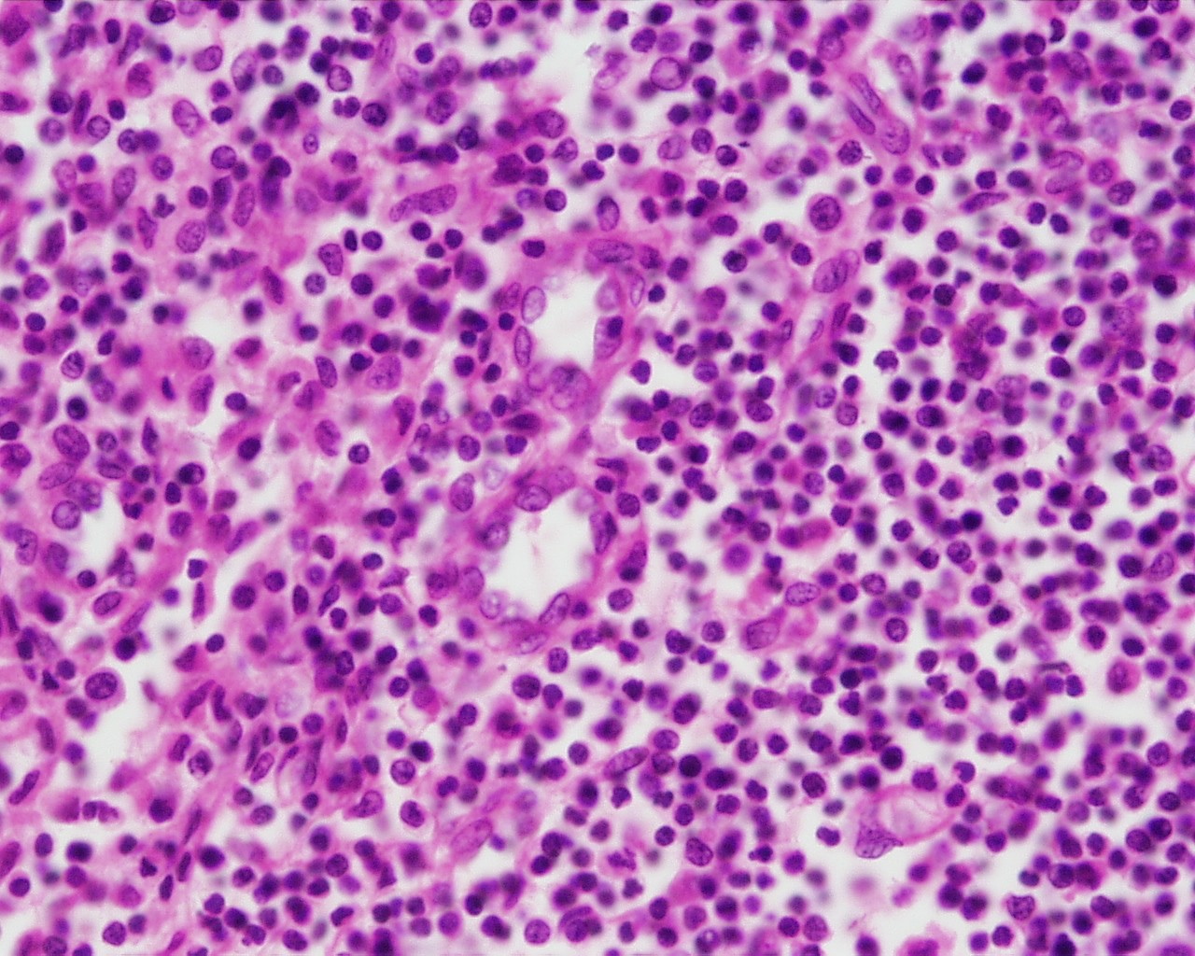
Capillaries
Capillary
G. Meyer – ANHB, UWA
L. Slomianka – ANHB, UWA

Slide 8
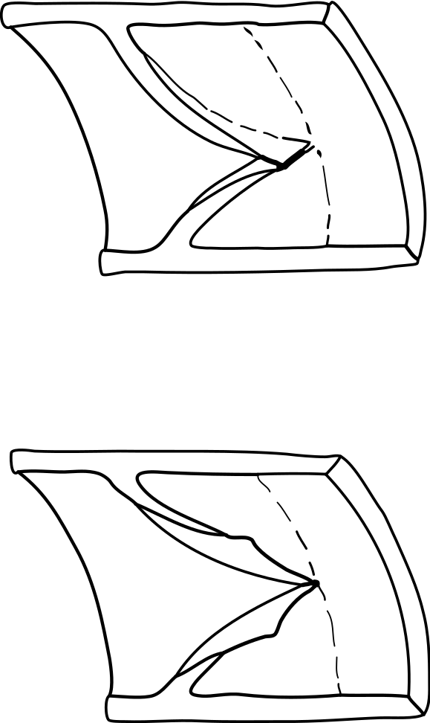
Veins contain valves to prevent the back flow of blood
Valve open
Valve closed

Slide 9
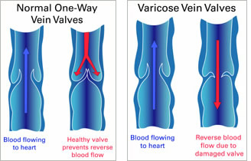

Slide 10
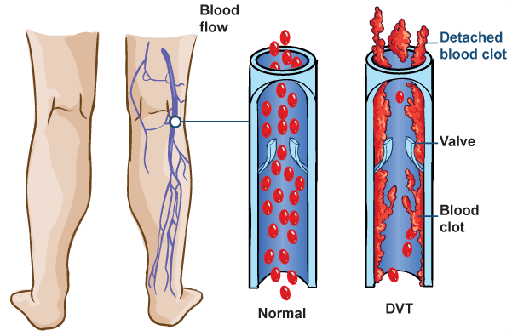

Slide 11
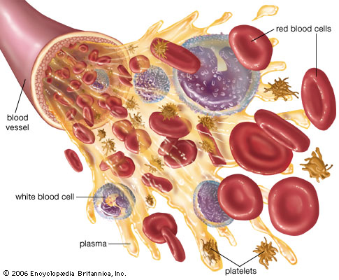
Blood Cells

Slide 12
The Main Components of Blood
Component | Function
Plasma (55%) | Transport of: Oxygen Digested food Carbon dioxide Wastes Hormones Salts Heat
Blood Cells (45%) Red blood cells White blood cells Platelets | Carry oxygen Protect the body Clotting of the blood

Slide 13
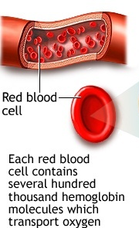
Red Blood cell
Life Span = 120 days
No Nucleus present to save space for carrying oxygen & to go through narrow spaces and capillaries.
Haemoglobin is present to attach to oxygen.

Slide 14
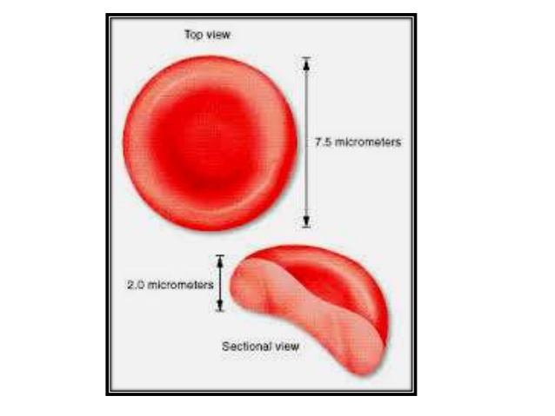

Slide 15
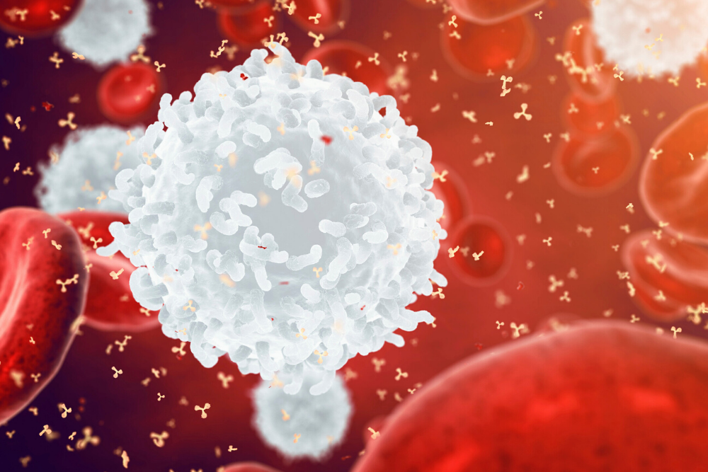
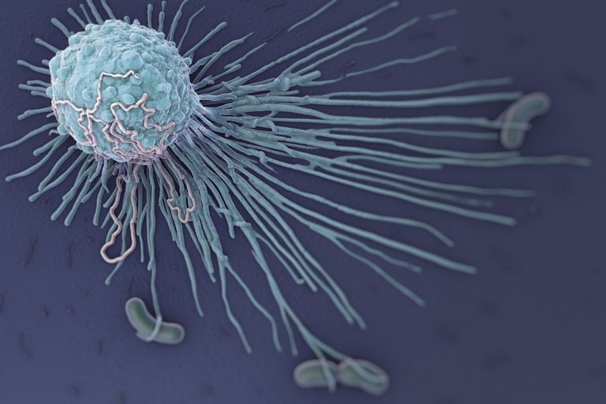
White Blood Cells
Fights infections and foreign substances by engulfing and destroying them (phagocytosis).
Shape varies so that they can squeeze between cells in the tissues.

Slide 16
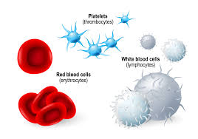
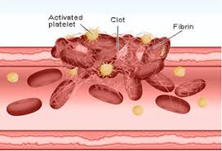
Platelets
Irregular shape to help in clotting blood to stop bleeding.

Slide 17
Functioning Body Systems
How does the circulatory system work with other body systems?

Slide 18
Answer:
The circulatory system works with the respiratory system to provide oxygen to cells;
It works with the urinary and digestive systems to remove waste products;
It helps give skin colour;
It is under control of the nervous system.

